Slide 1
Creating & Customizing Content
Notes:
SharePoint Designer 2010 can be used to create the SharePoint site structure and manage its content. Creating Content types, site columns, web part pages, web parts, and managing site security can all be accomplished using this application. This module shows how a site administrator can create components much more quickly and efficiently using SharePoint Designer as opposed to using the browser.

Slide 2
Agenda
Create Sites with SharePoint Designer 2010
Managing Site Navigation Options
Working with Lists and Libraries
Creating/Modifying Views & Forms in Lists & Libraries
Managing Site Columns & Content Types
Web Part Pages vs. Wiki Pages

Slide 3
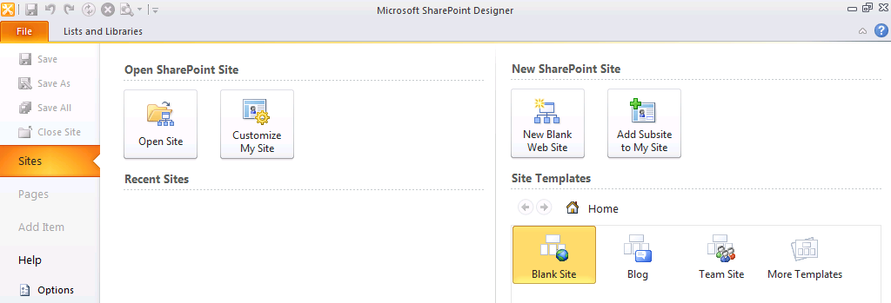
SharePoint Designer Requires SharePoint
You must create a new site or open existing one to work within SharePoint Designer
Notes:
SPD 2010 can only be used to open up SharePoint sites (this was not the case with SPD 2007 which let you work with non-SharePoint sites).
SPD cannot be used to create site collections. A site collection must already exist before you open up SPD. When SPD is first opened, Backstage is used to create new sites or open existing sites.

Slide 4
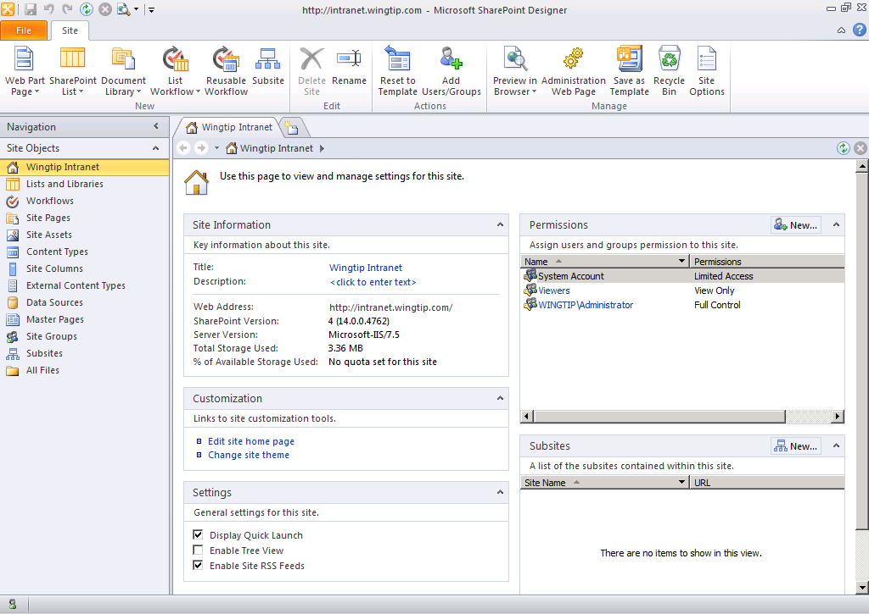
Working with SharePoint Sites
Manage Site Information
Manage Permissions
Site
Customization
Change General Settings
Create Subsites
Notes:
Site name and description can be changed from Site Information section. The Web address for site and total storage used (for site collection) and more appears in this section as well.
Customization section provides the link to edit the site’s home page. Also, clicking Change site theme will take you to the browser to change the site theme there.
Settings section contains checkboxes to enable/disable Quick Launch, Tree View and RSS feeds. Even if Quick Launch and Tree View are both disabled, you will still see left navigation on the website with Recycle Bin and All Site Content links.

Slide 5
Agenda
Create Sites with SharePoint Designer 2010
Managing Site Navigation Options
Working with Lists and Libraries
Creating/Modifying Views & Forms in Lists & Libraries
Managing Site Columns & Content Types
Web Part Pages vs. Wiki Pages

Slide 6
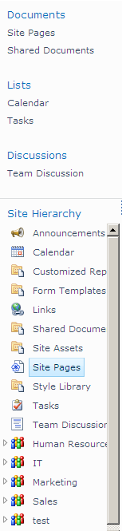
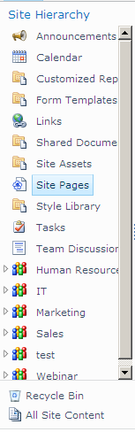
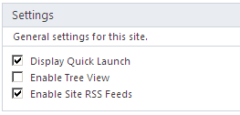
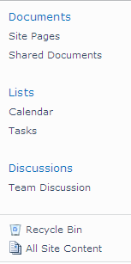

Customizing Site Navigation
Enable / Disable Quick Launch & Tree View
Quick Launch &
Tree View
Tree View
Quick Launch
None
Notes:
The Quick Launch and Tree View for SharePoint sites can be enabled/disabled from the site’s Summary Page. Even if both are disabled, the left side navigation will still show links to Recycle Bin and All Site Content.
The links in Quick Launch and Tree View are all security trimmed.

Slide 7
DEMO
Creating & Customizing SharePoint Site and Metadata

Slide 8
Agenda
Create Sites with SharePoint Designer 2010
Managing Site Navigation Options
Working with Lists and Libraries
Creating/Modifying Views & Forms in Lists & Libraries
Managing Site Columns & Content Types
Web Part Pages vs. Wiki Pages

Slide 9
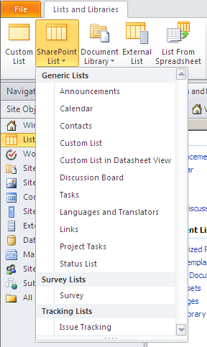
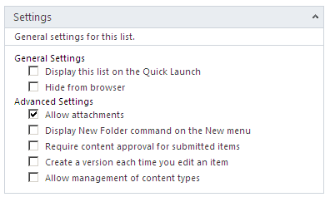
Managing Lists
SharePoint Designer can:
Create Lists and Libraries
Manage List properties
Notes:
Lists and Libraries in SharePoint sites serve the purpose of holding on to your information in a structured manner. You can then decide to deploy and display them as you wish to the users by creating views on them. Use SPD, to quickly create Lists and Libraries and set their settings.
If one of the pre-defined types of lists does not do the trick, then create a Custom List to build from scratch.

Slide 10
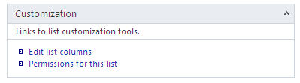
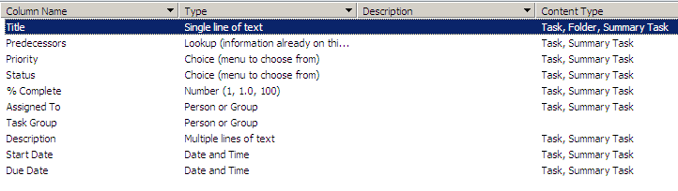
Edit Column Schema
Manage the metadata for the list
List Columns and Site Columns
Notes:
The columns for a list/library can be created and managed directly from within SPD. List columns and site columns are both available for use.

Slide 11
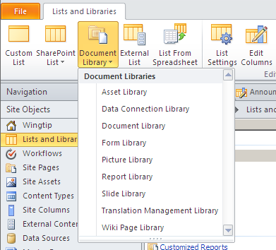
Creating Document Libraries
Multiple types of libraries can be created
Notes:
The well used Document Library, the not so well known Translation Management Library and all libraries in between can be created for the site using the SPD interface.

Slide 12
Agenda
Create Sites with SharePoint Designer 2010
Managing Site Navigation Options
Working with Lists and Libraries
Creating/Modifying Views & Forms in Lists & Libraries
Managing Site Columns & Content Types
Web Part Pages vs. Wiki Pages

Slide 13
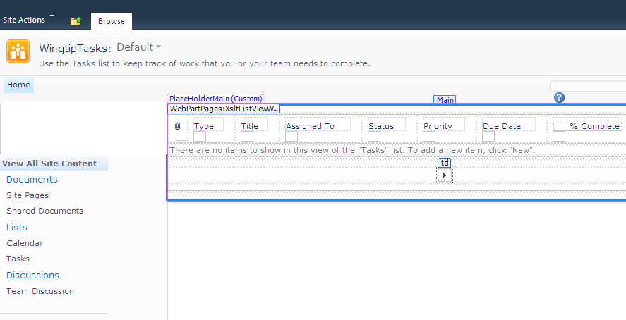
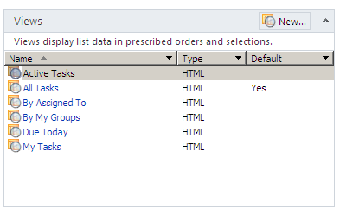
Views of Lists and Libraries
List and Library Views are used to present information to users
Create new views and manage existing out of box views
Notes:
Views on Lists and Libraries are analogous to views on tables in databases. They are used to present stored information to the user in a variety of ways.
Multiple views are predefined for each list and library. However, you are not restricted to only these views. New views can be easily created using SPD.

Slide 14
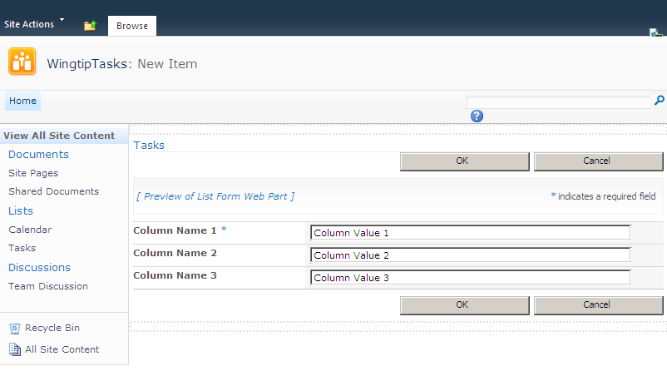
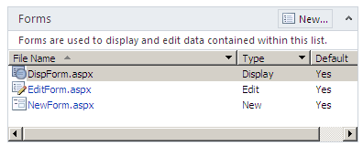
Edit Existing Forms and Create New Ones
Forms available for users to manage List and Library data
Display
Edit
Create
Create additional ones as needed
Notes:
Every list and library exposes forms to the end users in order to be able to manage the list data. The typical forms that come out of the box are to display, edit and create new data. These forms can be managed and changed as needed. Additional forms can be created as well. However, keep in mind that there can be only one default form for each type.

Slide 15
DEMO
Managing Lists and Libraries

Slide 16
Agenda
Create Sites with SharePoint Designer 2010
Managing Site Navigation Options
Working with Lists and Libraries
Creating/Modifying Views & Forms in Lists & Libraries
Managing Site Columns & Content Types
Web Part Pages vs. Wiki Pages

Slide 17
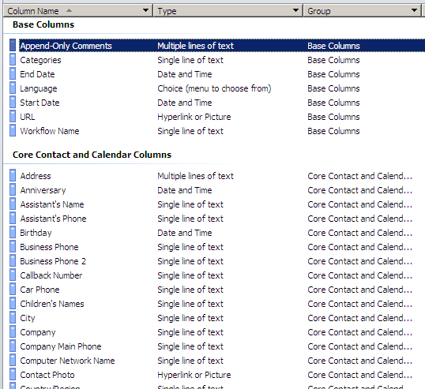
Site Column Creation
Reusable column definitions
Defined at the site level
Inherited by subsites
Notes:
Site columns are defined at the site level and inherited to subsites. They are used to define settings and default choices of columns which can then be reused in multiple lists, libraries, and content types as needed. Updates to site columns can be pushed to all places where it’s being used.

Slide 18
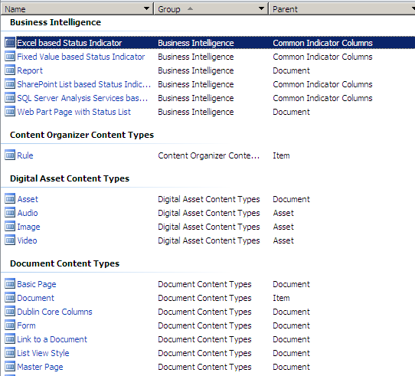
Instantiate new Content Types
Reusable collection of settings and columns
Defined at the site level
Inherited by subsites
Notes:
Content types were introduced in Windows SharePoint Services 3.0. They are used to design and organize SharePoint content in a reusable and more meaningful way.

Slide 19
DEMO
Creating Site Columns and Content Types

Slide 20
Agenda
Create Sites with SharePoint Designer 2010
Managing Site Navigation Options
Working with Lists and Libraries
Creating/Modifying Views & Forms in Lists & Libraries
Managing Site Columns & Content Types
Web Part Pages vs. Wiki Pages

Slide 21
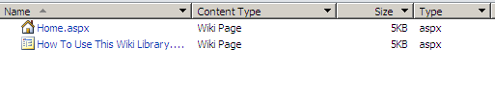
Manage Pages in Site Pages Library
Site Pages library is a Wiki type of library
Pages in library can be linked to each other
All site pages are recommended to be stored in this library
Notes:
Site Pages library is a wiki library. This library is instantiated automatically when a Team Site is created and it holds pages for the site. The specialty of this library is that the pages in this library can be linked organically (using the [[…]] notation). Also, the pages themselves are automatically versioned to keep history of changes.
Two pages created by default in this library:
Home.aspx
How to Use This Wiki Library.aspx
Additional pages can be created using the browser or SPD.

Slide 22
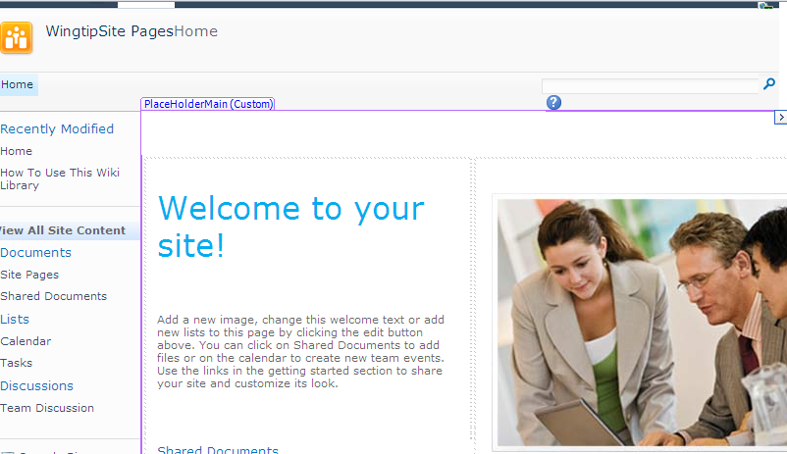
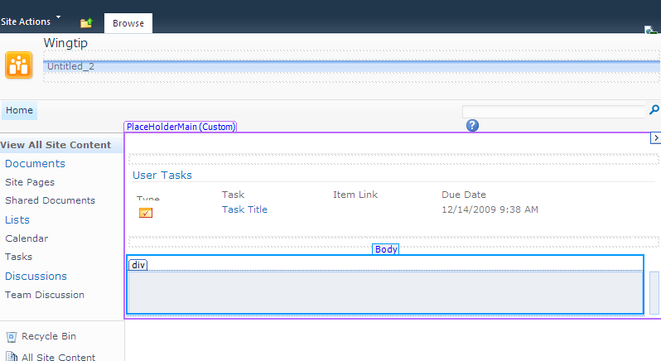
Wiki Pages vs. Web Part Pages
Wiki Pages
Type text directly on page
Link to other pages in the library
Insert Web Parts
Web Part Pages
Web Part Zones to hold Web Parts
Zones can be customized as needed
Notes:
Wiki Pages
Contains rich text content placeholders.
Text can be inserted directly and formatted using Live Preview.
Web Parts and List Views can be placed on the page.
Other pages in the library can be organically linked together.
Web Part Page
Contains Web Part Zones for holding Web Parts.
Web Part Zones can be customized to arrange Web Parts horizontally or vertically.
Zones can also be locked down to prevent end user customizations.

Slide 23
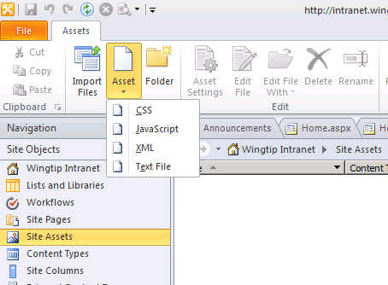
Create Site Assets
Use Site Assets library to store resource files which are needed for the site
Images
CSS
JavaScript
XML
Text File
Notes:
Site Assets library is created automatically when a new Team Site is created. Primarily, this library is used to store the images displayed on site pages. Additionally, other resource files such as JavaScript, styles, XML and simply text files can also be placed in this library and used in the site.

Slide 24
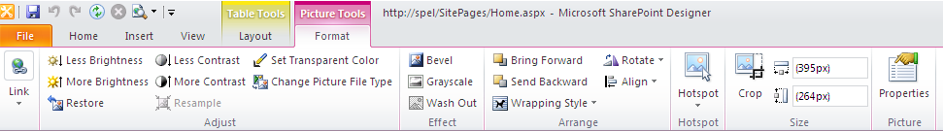
Formatting Images
Insert and format images easily using SPD
Basic image editing tasks available in Picture Tools tab in the ribbon
Adjusting brightness
Image rotation
Image resizing
Notes:
Images for display on site pages are stored in the Site Assets library. These can be easily inserted using SPD. Once placed on the page, the SPD ribbon supports image editing. It works as a ‘lightweight’ image editing tool and tasks such as adjusting brightness, contrast, size and more can be manipulated directly from within SPD.

Slide 25
DEMO
Site Pages and Site Assets Libraries

Slide 26
Summary
Create Sites with SharePoint Designer 2010
Managing Site Navigation Options
Working with Lists and Libraries
Creating/Modifying Views & Forms in Lists & Libraries
Managing Site Columns & Content Types
Web Part Pages vs. Wiki Pages

